Slide 1

IOT BASED QUALITY MONITORING SYSTEM FOR BANANA BEER.
Presented by:
UWIZEYIMANA Abdulkarim (220020691)
Supervised by:
Dr Omar Gatera &
Dr. Omololu Akin-ojo

Slide 2
Introduction
This presentation explains a prototype-driven research to prove the concept of how the industrial revolution technologies leading to the 4th generation, namely IoT, AI can be integrated to develop eLab Beer Quality Tester; the project title is named IoT based quality monitoring for banana beer .
The outcome prototype features an embedded system and web based cloud system proving how traditional optimization methods such as response surface methodology (RSM) require further comparison with a relevant machine learning system;thanks to Artificial Intelligence (AI) which is an effective non-linear multivariate tool in bioprocessing, with enormous generalization, prediction, and validation capabilities.

Slide 3

PROBLEM STATEMENT
Irregularity of quality parameters in an urwagwa drink of the same ingredients on the market can be a root cause of chronic diseases like blood pressure, blood sugar level,cancer and mental health issues and even consumer death that are caused by low quality standards of this beers.
Data accuracy and transparency of the beer produced products on the markets.

Slide 4



Objectives
Specific objectives
SO1: To design and simulate an eLab Beers Quality Tester that can dectect and record banana beer ingredients and provide meaningful output
SO2: Easy retrieval and analysis of captured data as they can be sent to the cloud for visualization, analytics and future use in case needed.
SO3: To validate the good operation of the prototyped end to end system in factories , standardisation and health entities.
Main objective:
is to develop an affordable IoT based Device that can support banana beer processors and users to determine homemade beer quality anytime and anywhere and create cloud data storage for future use and further analysis of the products.

Slide 5

Hypothesis
The general hypothesis of this study is to show how the current IoT sensing technologies can efficiently collect microbial and biochemical parameters of the banana beer.
1
Integration of IoT and ML can be leveraged to detect the unnecessary amount of microbial and biochemical in the banana beer processed alcoholic.
2
3
There is available technology that could be used to create ML models capable of data processing.

Slide 6

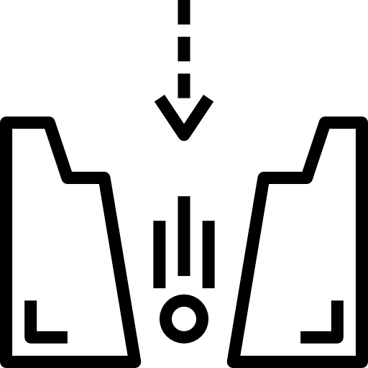
Literature review
Feasibility of IoT and ML integration
An overview study was done on integrating Artificial intelligence to IoT
Cloud computing is important for open systems, database and web services created on online.
Limitations is the high cost of precise and accurate sensors
which increases overall cost of the product on the market
The gap to be covered by this study is specifying the need of ML for fast data processing and accuracy

Slide 7
Literature review cont
S/N | AUTHORS | Technique applied | Accomplishment | Gaps and Remarks
1 | K. Aschbacher et al. [1] | Machine learning prediction of blood alcohol concentration: a digital signature of smart-breathalyzer behavior | Equality | Doesn't address beer quality
2 | Edwin et. al. [2] | A modeling method for the development of a bioprocess to optimally produce umqombothi (a South African traditional beer) | Resource Utilization | Complex architecture
3 | Wilson et al.[29] | Microbial and Biochemical Changes Occurring During Production of Traditional Rwandese Banana Beer “Urwagwa” | complaints in the Rwandese Banana Beer “Urwagwa” | The block diagram was not clear and sequence diagram does not include ML method

Slide 8
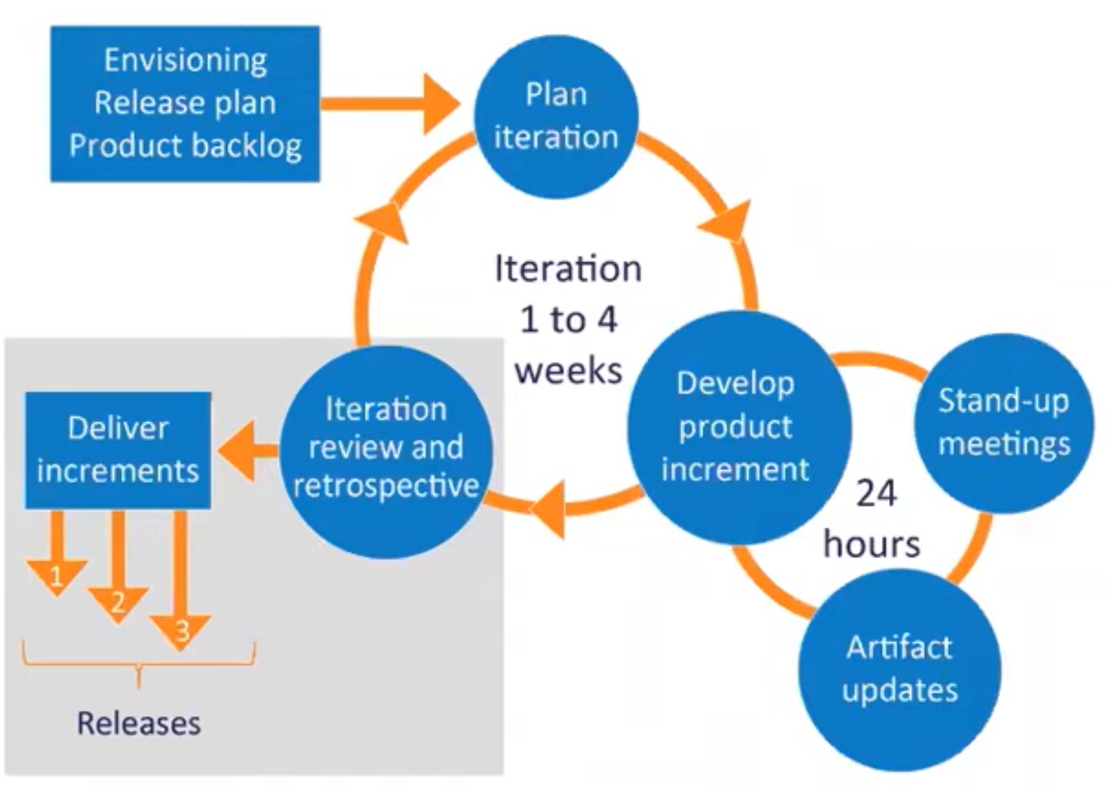
Research methodology
The research process was first initiated to investigate how to incorporate IoT technologies and artificial intelligent. The prototype research was then narrowed down after comprehensive literature review and business case analysis to vision integrated IoT with Machine Learning to detect biochemical parameters and predict banana beer quality

Slide 9
Prototype research steps
Embedded design
5
Literature review
1
2
System test and debugging
6
State of the art analysis
Focuses on the system design and its different block diagram.
Results analysis
7
3
Inference data cleaning and processing; software coding design
4

Slide 10
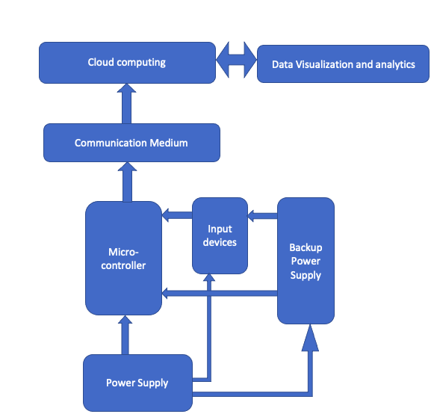
System block diagram design

Slide 11
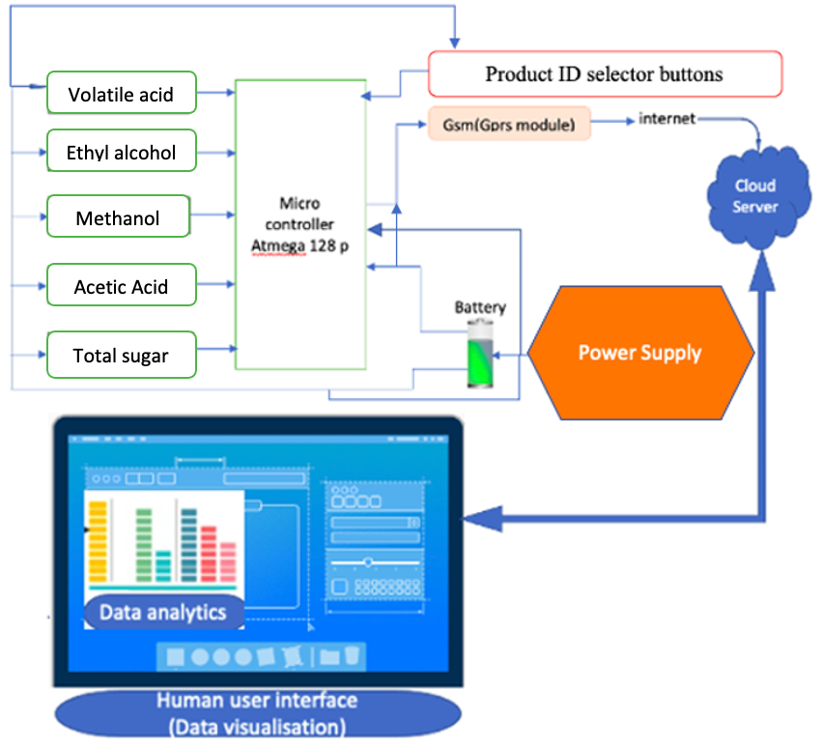
System high level Design

Slide 12
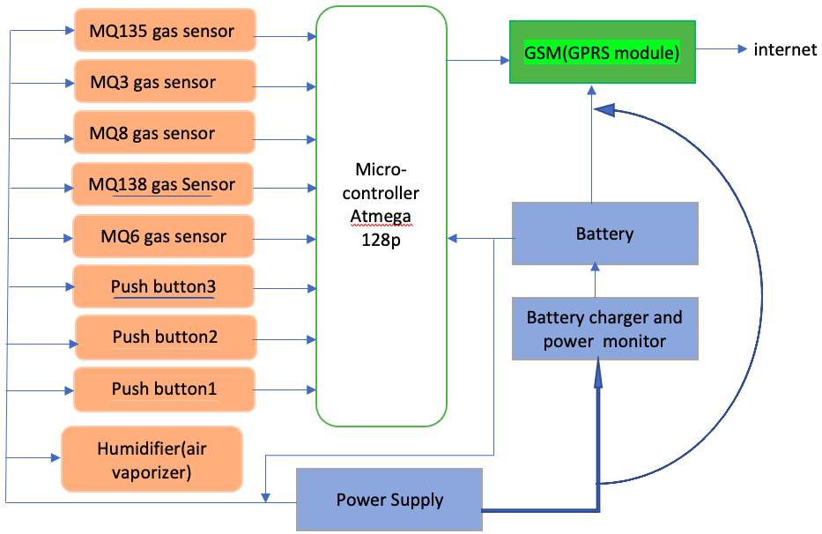
Embedded System Design

Slide 13
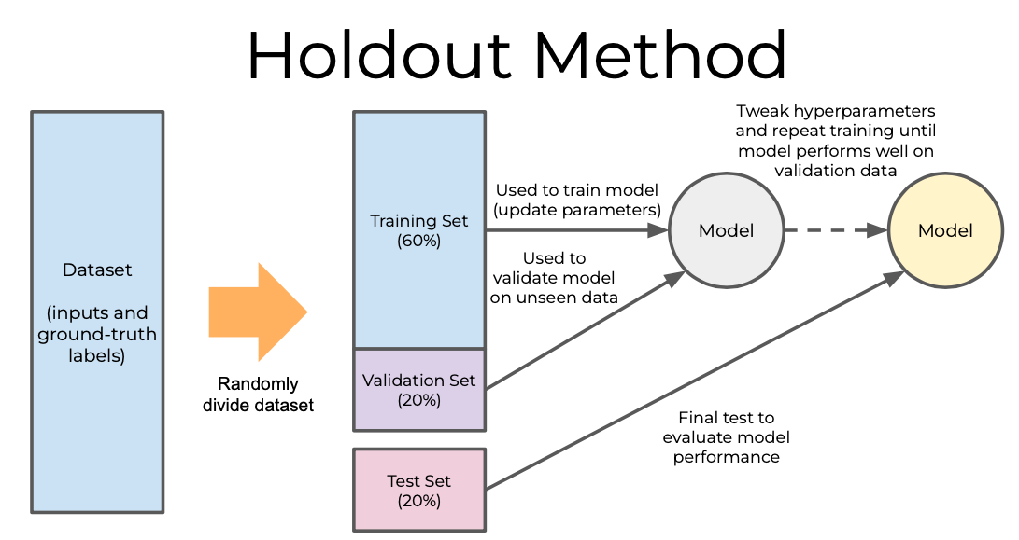
ML model design method
Expected result class
ABV value in % | Type | Description
0.05 | Non-alcohol drinks | Classified as free alcohol drinks
<0.05>=1.2 | Low-alcohol drinks | Classified as soft drinks
4 to 5 | Larger drinks | Classified as low fermented beers
10 to higher | Spirit drinks | Classified as liqueurs beer

Slide 14
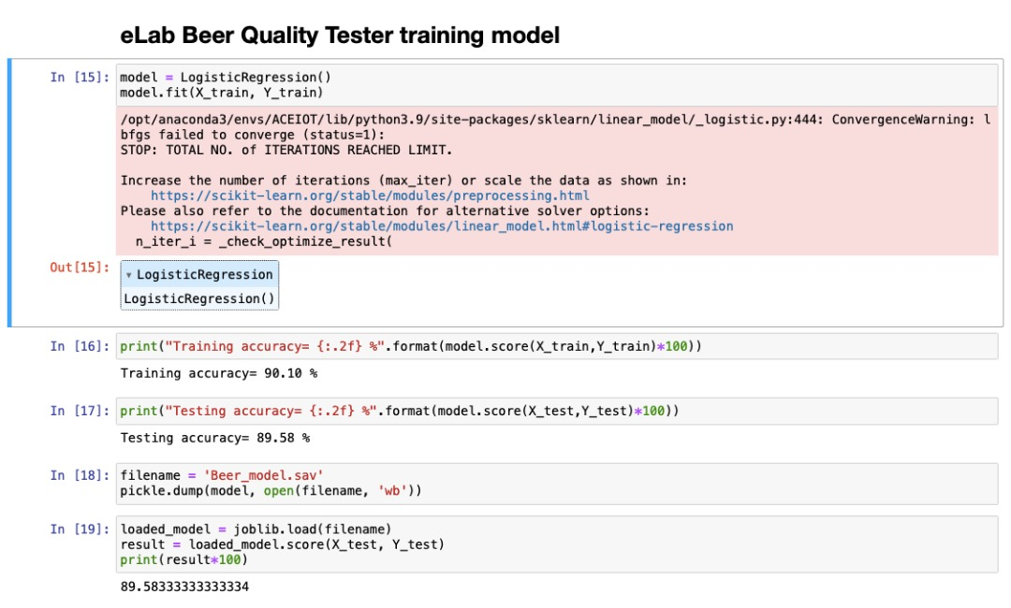
System ML Model

Slide 15
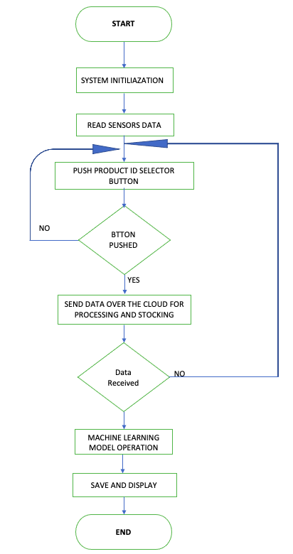
System flowchart diagram

Slide 16
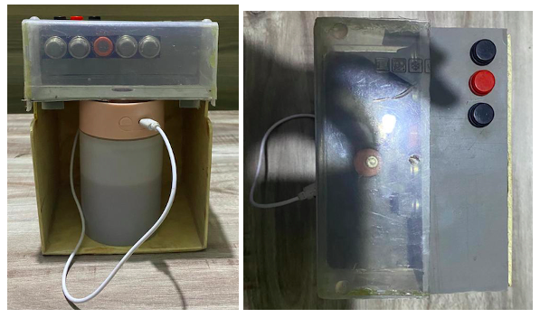
SYSTEM HARDWARE
Input Gas Sensors
Liquid vaporizer
Product ID Selector buttons
Liquid Container
Hardware System Housing
Liquid Container box

Slide 17
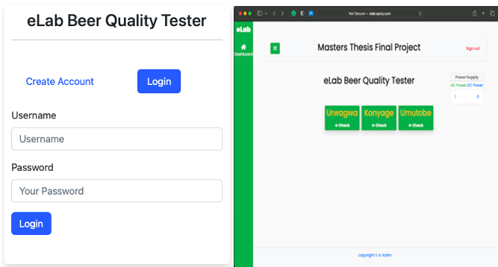
System user interface dashboard
System login page
System main dashboard

Slide 18
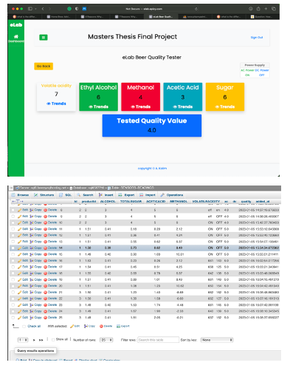
Data simulation and results
Online based user interface
Cloud Database

Slide 19
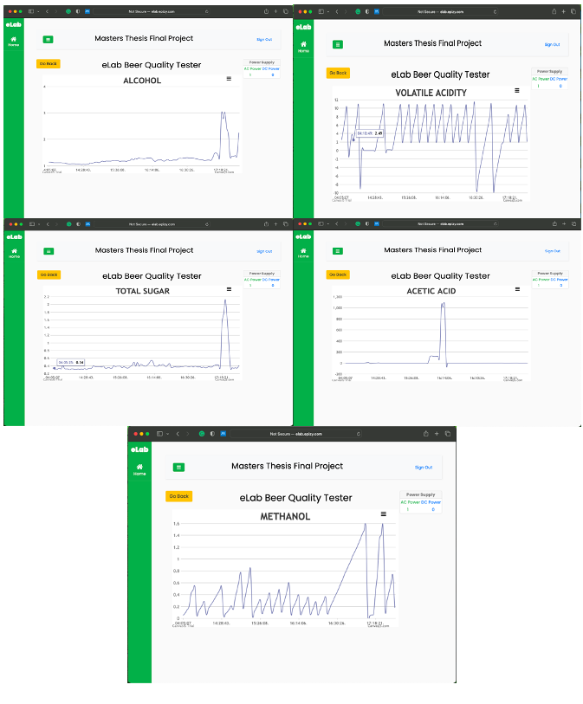
Data records for future analysis and improvement
Data trend histories

Slide 20
Conclusions
This study presented a research-driven design and prototyping process to build an end-to-end system that uses an Arduino microcontroller embedding gas sensors, network module, product ID selector and power management , a trained AI model to read low data captured by the gas sensors and predict beer quality value
The experimentation carried out on local banana beer product shows that the proposed system achieves a 89% of accuracy for biochemical parameters detection.

Slide 21
Recommendation
This project operational model is to use IoT embedded system to collect raw data, send them on the cloud for further processing, decision making and data storage; the improvement to this project can be edge data processing instead of cloud processing in order to reduce latency time between low data transmission, data processing and decision making.
This system can be more easy to use if additional functionalities like embedded screen added for easy access on screen instructions and system accuracy can be improved the appropriate devices are used and more data are available for ML model training.

Slide 22
Thank you for your attention!
Q/A and live demo.

